Slide 1
WSD Athletics and Actitivies
2016
Board Presentation

Slide 2
What we know based on research…
  School climate affects student achievement
  Athletes affect school climate
    Athletes as servant leaders can make a real difference!
    (Volunteer work, captain trainings, coach/teacher alliances, W club, accountability both in and out of competition, M.O.C. program, no sense of entitlement)

Slide 3


The Woodland Way
ELM Tree of Mastery
Effort
Learning
Mistakes
All in… All out… All the time
Compete FEARLESSLY
(Effort mistakes are OK)

Slide 4
WSD Athletics
ONE PROGRAM
WSD AD
WMS AD
WHS Head Coaches
WMS Head Coaches
WHS Asst Coaches
WMS Asst Coaches
Youth Programs

Slide 5
WSD Athletics/Activities
Sports we offer
Competitive Clubs we offer
WMS
Fall
Boys’ Golf
Cross Country
Football
Volleyball
Winter
Boys’ Basketball
Girls’ Basketball
Boys’ Wrestling
Girls’ Wrestling
Spring
Girls’ Golf
Track and Field
Robotics
Knowledge Bowl
WHS
Knowledge Bowl
FBLA
Skills USA
HOSA
FFA
Equestrian
Trap
Band/Jazz Band
Performance Choir
Fall
Boys’ Golf
Cheer
Cross Country
Dance
Girls’ Soccer
Football
Volleyball
Girls’ Swimming
Winter
Boys’ Basketball
Girls’ Basketball
Cheer
Dance
Boys’ Swimming
Boys’ Wrestling
Girls’ Wrestling
Spring
Baseball
Fastpitch
Girls’ Golf
Boys’ Soccer
Track and Field

Slide 6
WSD Activities/Athletics
Participation Numbers
Knowledge Bowl (3 girls, 9 boys)
FBLA (17 girls, 24 boys)
Skills USA – Metals (7 boys)
Skills USA – FCSE (11 girls, 1 boy)
HOSA (16 girls, 2 boys)
FFA (17 girls, 10 boys)
Equestrian (11 girls, 1 boy)
Trap (2 girls, 14 boys)
Jazz Band (4 girls, 10 boys)
Performance Choir (12 girls, 7 boys)
Robotics (7 girls, 2 boys)
Knowledge Bowl (10 girls, 9 boys)
Trap (2 Boys)
Participation Fee Waiver Requests: 20 (WHS)
Participation Fee Waiver Requests: 30 (WMS)

Slide 7
WSD Athletics
2015-16 Survey Results (Grade 7-12)
Top 4 Sports kids wished we offered at WHS:
  Bowling (20.7%)
  Fencing (18.6%)
  Swimming/Diving (18.4%)
  Competitive Martial Arts (18.4%)
Top 4 Sports kids wished we offered at WMS:
  Soccer (41%)
  Swimming/Diving (25.8%)
  Gymnastics (18.5%)
  Bowling (17.3%)
Top 4 Reasons kids don’t participate at WHS:
  I’m not interested in sports (44.1%)
  I’m not interested in sports offered at my school (18.9%)
  I have after school family responsibilities (19.8%)
  I have an after school job (13.5%)
Top 4 Reasons kids don’t participate at WMS:
  I’m not interested in sports (40.4%)
  I’m not interested in the sports offered in my school (21.3%)
  My religion won’t allow it (12.8%)
  I have after school family responsibilities (9.9%)

Slide 8
WSD Athletic Program
Challenges

Slide 9
WSD Program Coordination
Developing a coordinated skill progression from youth – HS
  WMS Feeder programs
    Golf
    Cross Country
    Cheer – proposed for next year
    Dance – proposed for next year
    Soccer – interest is there, facilities in place
  Community Feeder programs
    Challenges…
      Time, money and other resources
      Summer camps, youth clinics

Slide 10

Pressure to specialize
The real facts about multi-sport athletes
90% of Ohio State Football Scholarships were multi sport athletes in high school
122 out of 128 NFL QBs were multi sport athletes in high school
Specializing causes more wear and tear and increases risk (repetitive motions)
Different sports can make you a more complete athlete – mentally and physically.
Greater upside to college recruiters
Enjoy the high school experience - BEAVER PRIDE!
19 out of 25 WHS athletes currently competing in college were multi-sport at WHS.
Way more scholarship $ overall in academics/merit.

Slide 11
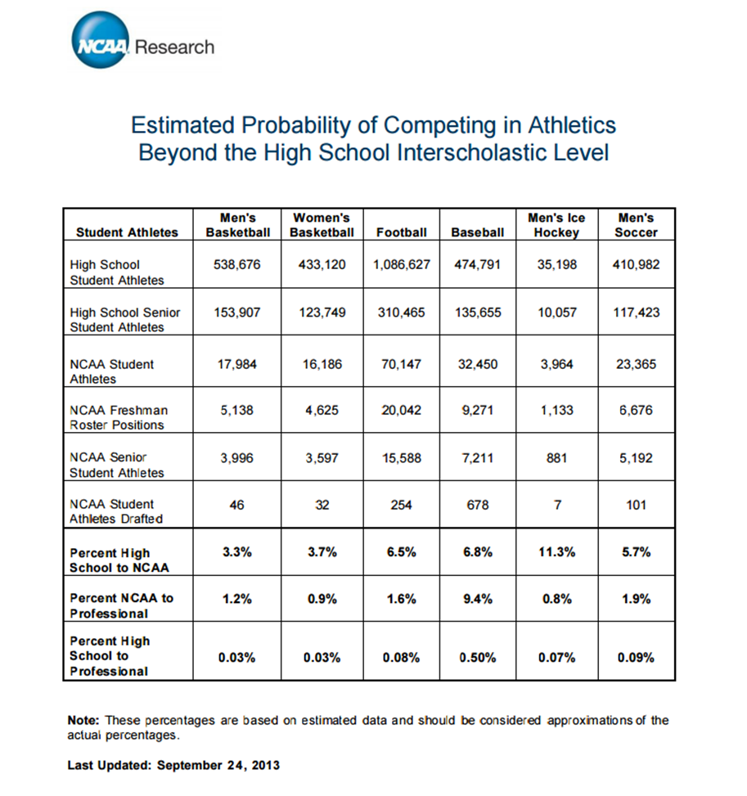

Keeping things in perspective…

Slide 12

Lawnmower Parents
Parent/Coach confrontations
  Inappropriate/disrespectful emails and texts
  Questioning coach on playing time, personnel decisions and strategy
    Why that can’t (and doesn’t) work…
    Root of 99% of issues… PLAYING TIME.
Adversity isn’t necessarily a bad thing… adverse situations provide opportunities for growth.

Slide 13
WSD Athletic Program
Expectations

Slide 14
Role as a WSD parent…
  4 Roles (Player, Parent, Coach, Official) – you fill one.
    Positive intent doesn’t always = positive results.
  Support your student athlete and the program.
  Allow your athlete to bring the game to you…
  Why are they playing?
  (Do your expectations align with theirs?)
    #1 answer on sports surveys…
One question to ask your athlete…

Slide 15
Parent/Coach Communications
If you have concerns…
Ways athlete can improve or concerns about treatment of your athlete are appropriate to discuss.
24 hour rule… never before/after/during game.
Stay away from texting and email – especially if you’re upset. Write it… just don’t send it. Call on the phone or make an appointment to talk in person.
Give your son/daughter the opportunity to work through adverse situations with coach and team on their own first. Encourage them to never give up or quit.

Slide 16
Role as a WSD athlete…
Effort above all else… ( with character and class)
Put your TEAM first (window or mirror?).
Compete Fearlessly!
Be responsible – treat your sport like a job.
Unhappy with your role on the team? Do something about it!
Have fun!

Slide 17
Academic Eligibility
Athletes on academic suspension may participate in practice, but not compete in games. The length of the suspension will vary based on the situation:
If a student does not pass five out of six classes at the end of a semester, they will be placed on academic suspension through the last Saturday in September or the first five weeks of the succeeding semester (WIAA 18.7.6).
If a student does not pass five out of six classes in the grading period previous to the sport in which they wish to participate (winter and spring), they will be placed on academic suspension for four weeks following the beginning of the season.
If a student is not passing five out of six classes during any grade check throughout the season, they will be placed on academic suspension for one week.
Athletes will remain on suspension for the duration of the suspension period and until they have met standard.
Athletes that have met standard but are below a 2.5 gpa will be placed on Academic Probation.
Athletes on academic probation may participate in practices and compete in games, providing the following conditions are met:
  Athlete must attend two ½ hour tutoring sessions per week.
  Athlete must have returned an academic probation letter to the athletic director (signed by parent and player).
  Athlete must turn in required tutoring form to their coach each Friday to be eligible on Monday.
  Athlete’s coach will monitor progress. If a coach believes the student is not making a valid effort to improve, participation time may be lost.
  Athlete must continue to pass five out of six classes.
If an athlete has a 2.5 or higher GPA at the next scheduled grade check, they will be removed from probation.

Slide 18
Sports Recognition Banquet

Slide 19
Scholar Athlete of the Year
“Luck is what happens when preparation meets opportunity.” – Darrel Royal

Slide 20
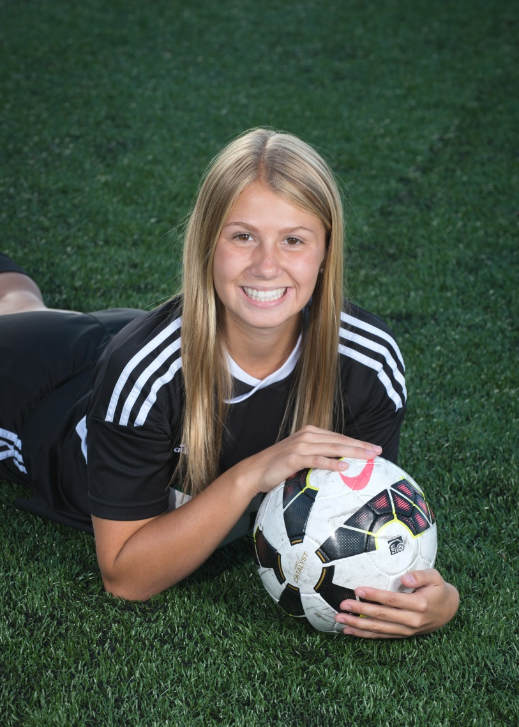
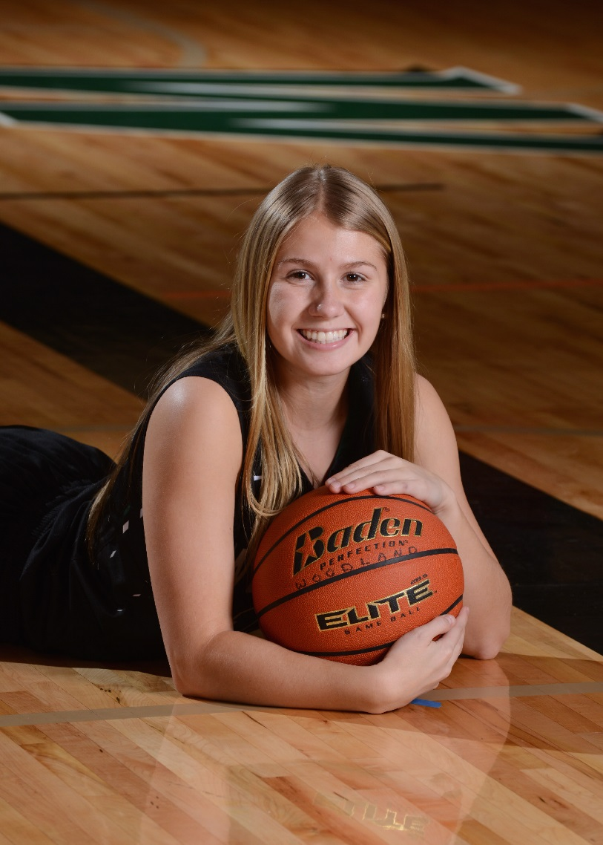
Cierra Daugherty
Attending Western Washington in the fall.

Slide 21

Dillon Franke
Attending Stanford in the fall.

Slide 22
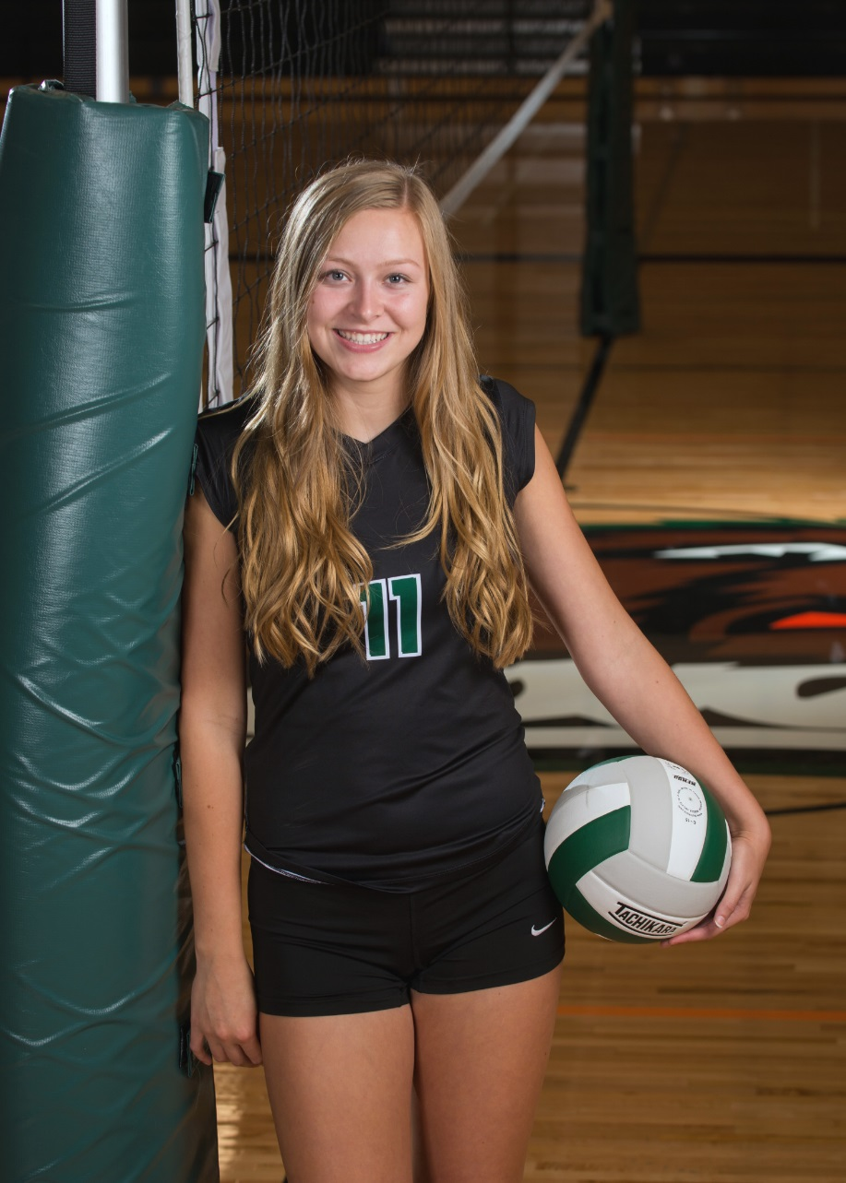
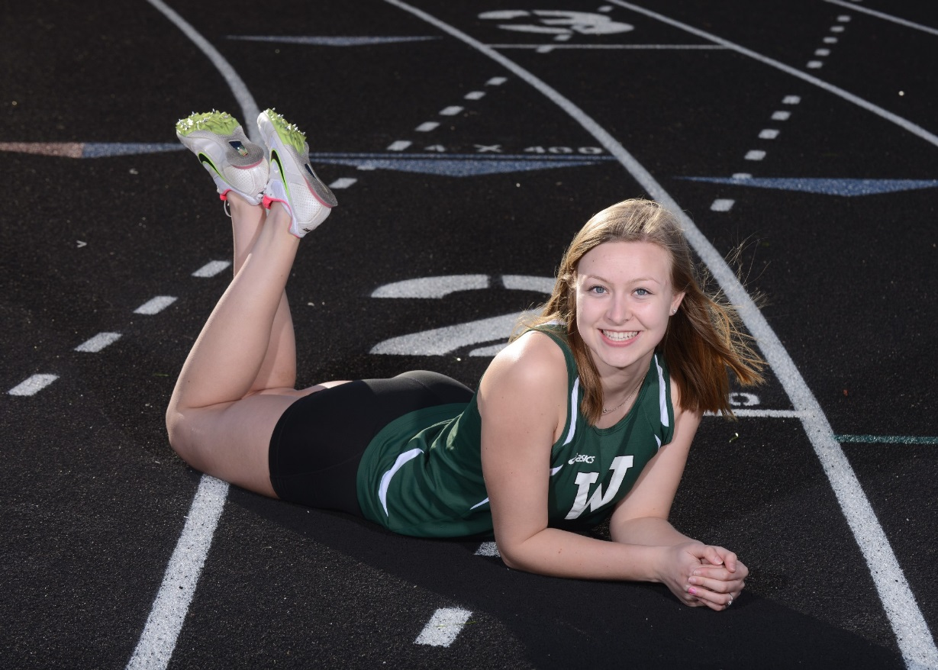
Kenya Byrnes
Attending Central Washington in the fall.

Slide 23
The Rudy Award
“Do you want to know who your best teammates are? Watch how they react when someone else does something good.” – Phil Beckner

Slide 24

McKay Flanagan
Attending Clark College in the fall.

Slide 25
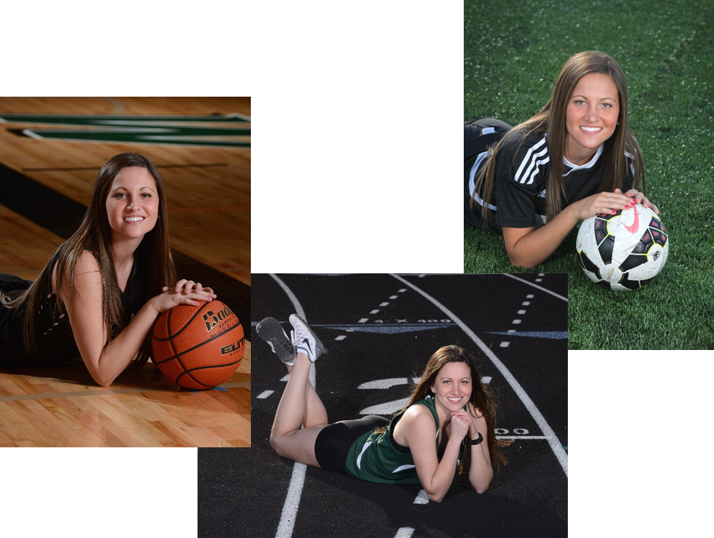
Katie Kern
Attending Concordia University in the fall.

Slide 26
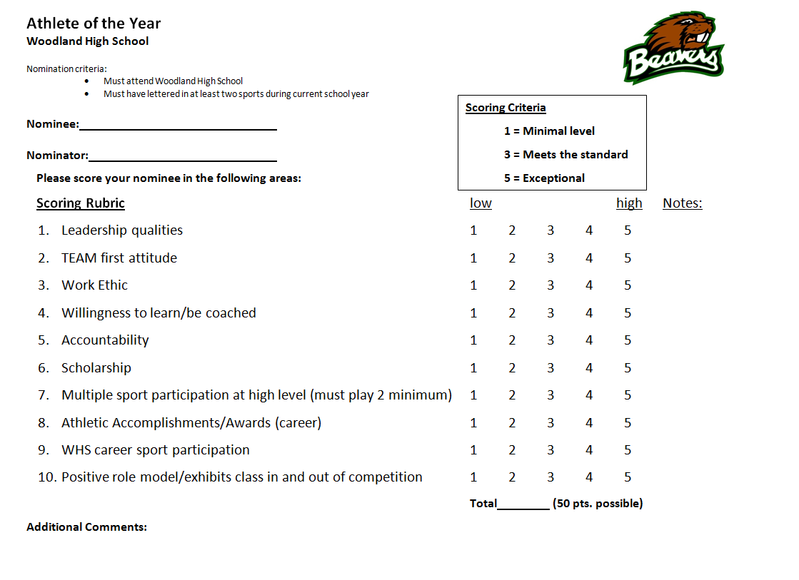

Slide 27
2016
WHS Athlete of the Year
Finalists

Slide 28
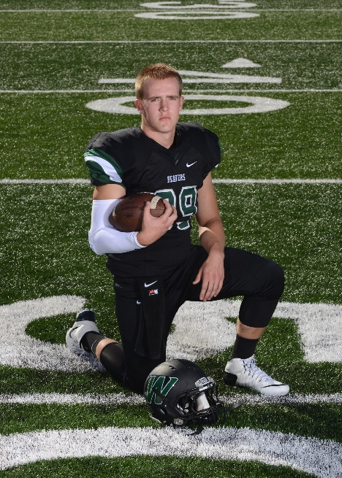
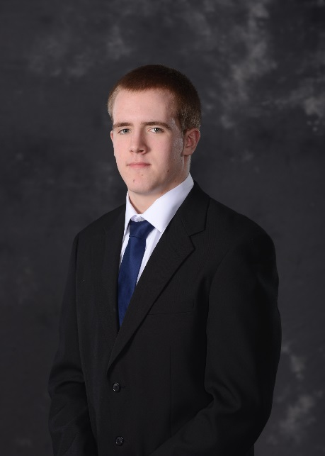
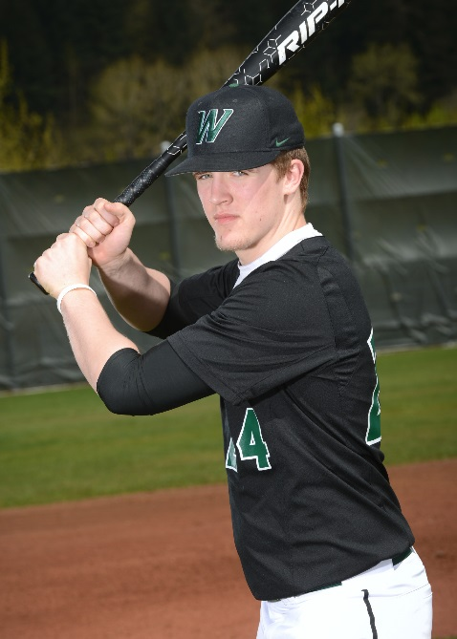
Accomplishments
Jared Cloud
Senior
3 year letter winner in Football
  1st team all-league (gr 11, 12)
  TDN all-area 2nd team (gr 11)
  TDN all-area 1st team (gr 12)
  Team Captain (gr 12)
  Coach Award (gr 12)
3 year letter winner in Wrestling
  State appearance (gr 10, 11)
  Team Captain (gr 12)
  Awarded top senior wrestler
  Has placed top 4 in over 10 tournaments in his career
  2nd in League (gr 11, 12)
1 year letter winner in Baseball
W Club President
Class President (gr 9, 10, 11)
ASB President (gr 12)
Joined 1,000 lb club (gr 11)
Founding Father of the Beaver Breakfast Club
National Football Foundation – Clark County Chapter Nominee
  3.4 GPA
  Attending Central Washington University in the fall.
Football (3)
Wrestling (3)
Baseball (1)

Slide 29
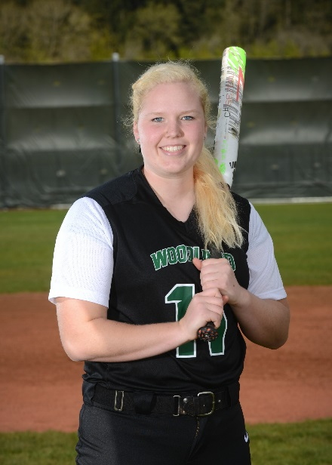
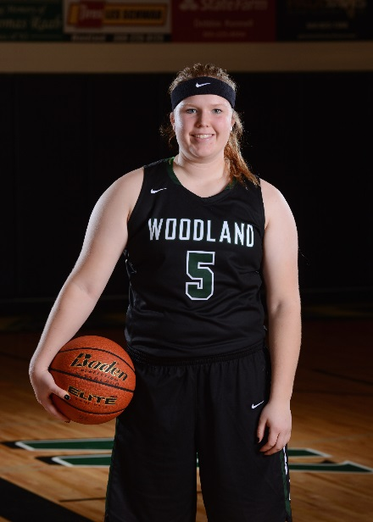
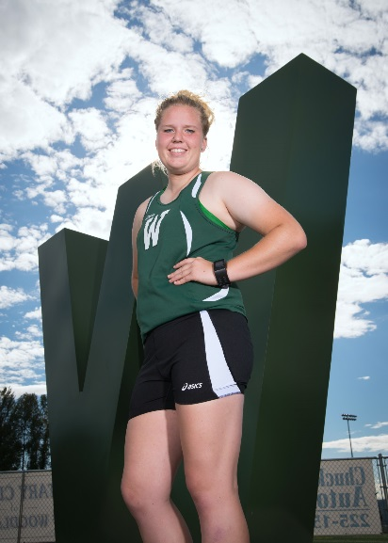
Jessica Flanagan
Senior
Accomplishments
1 year letter winner Cross Country
3 year letter winner Soccer
  2nd team all-league (gr 9)
  Offensive team MVP (gr 10)
  School record for goals (19) in a season (gr 10)
  1st team all-league (gr 10)
  1st team TDN all-area (gr 10)
  H.M. all-league (gr 11)
4 year letter winner Basketball
  Team MVP 3x (gr 9, 10, 11)
  1st team all-league 3x (gr 9, 10, 11)
  2nd team TDN all-area (gr 9)
  1st team TDN all-area (gr 10)
  2nd team TDN all-area (gr 11)
  TRICO League MVP (gr 10)
  Columbian Player of the Week (2x – gr 9)
  AP All-State Honorable Mention (gr 10)
  League/District Championship and best record in school history (gr 10)
  WIAA State Player of the Week (gr 11)
  Captain (gr 12)
  League MVP and TDN all-area 1st team (gr 12)
  Played in all-state game (gr 12)
  Played in Clark and Cowlitz all-star games (gr 12)
4 year letter winner Fastpitch
  Top batting average and runs scored (gr 9)
  1st team all-league 3x (gr 9, 10, 11)
  1st team TDN all-area (gr 10)
  Team 2nd in state (gr 9), 3rd in state (gr 10), 4th in state (gr 11)
  4x League Champions
  Co-League MVP (Defensive) (gr 11)
  Captain (gr 12)
  League Defensive MVP (gr 12)
  Named a top 10 female athlete in the area by the Columbian Newspaper (gr 9)
  1st team TDN All-Area in 3 sports (gr 10)
TDN 2014 Female Athlete of the Year (gr 10)
Has set multiple records in basketball (3pt Made, 3pt Attempts, Steals)
1000 point club in basketball
11 time all-league, 12 time letter winner
3.7 GPA
Attending Seattle University in the fall and will be playing fastpitch.
Fastpitch (4)
Basketball (4)
Cross Country (1)

Slide 30
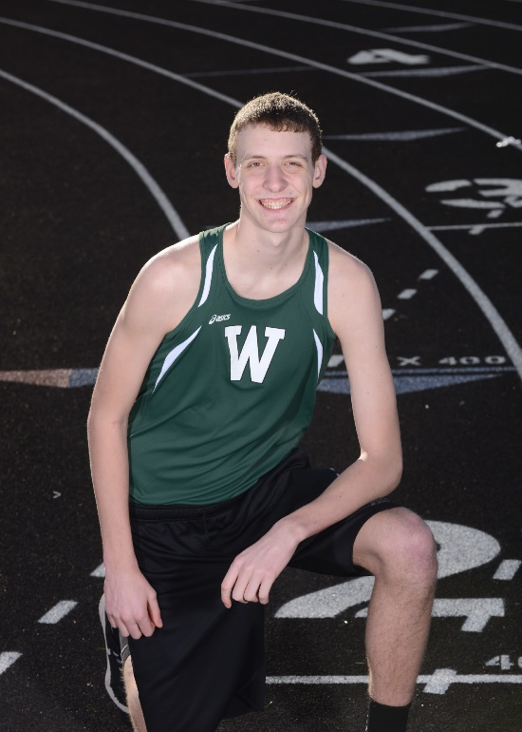
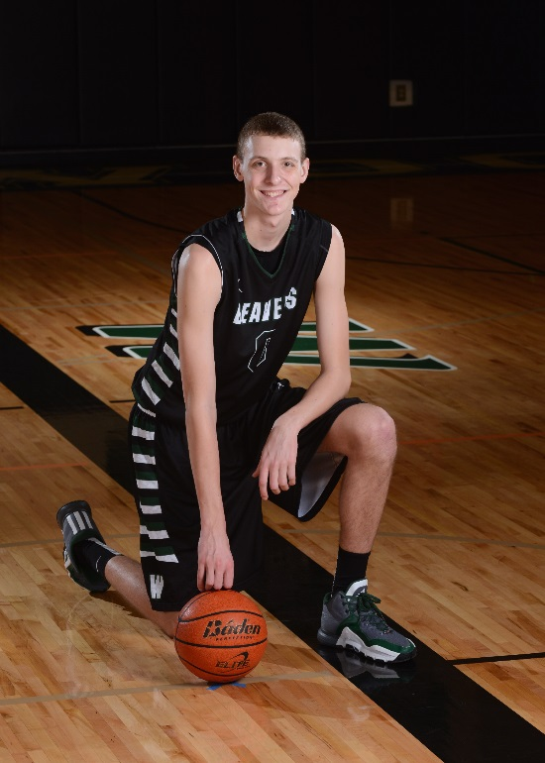
Accomplishments
Bryce Mulder
Junior
2 year letter winner in Basketball
  2nd team all-league (gr 10)
  WHS Defensive MVP (gr 10, 11)
  WHS shot block record (single season - 97) (gr11)
  WHS shot block record (career – 178) (gr 11)
  1st team all-league (gr 11)
  1st final 8 in state appearance since 1985
  T-7th in State
  League and District leader with 3.9 blocks per game
  2nd in state blocks per game
  TDN All-Area 2nd Team (gr 11)
1 year letter winner in Track
  6th in league in high jump
  6th in district – missed state by two inches.
3.6 GPA
Track (1)
Basketball (2)

Slide 31
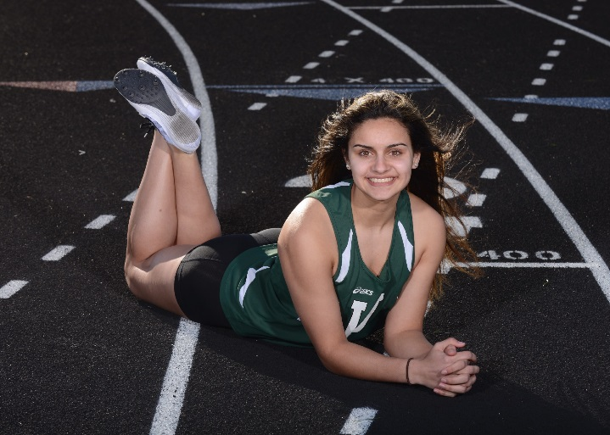
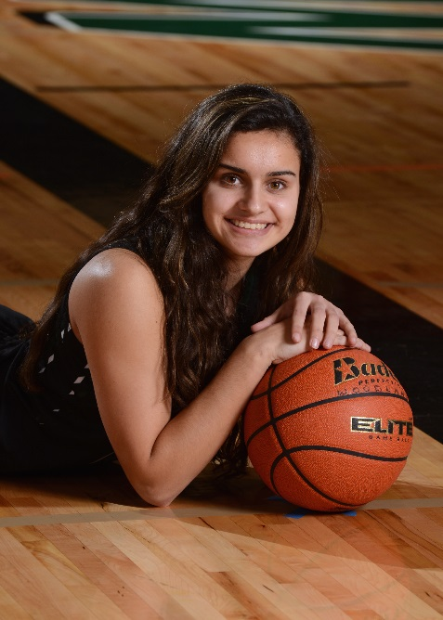
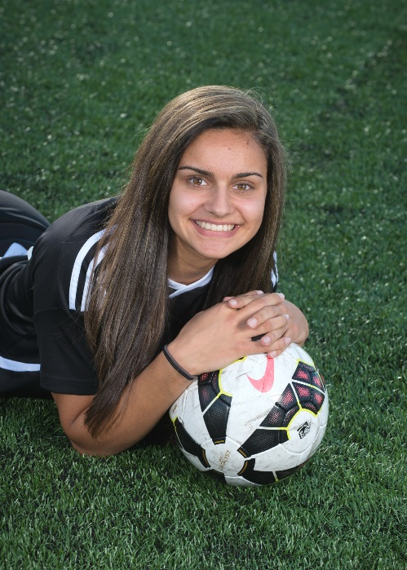
Amber Malik
Senior
Accomplishments
1 year letter winner Cross Country
3 year letter winner Soccer
  1st team all-league (gr 10)
  League champions (gr 10)
4 year letter winner Basketball
  WHS Defensive MVP (gr 10, 11, 12)
  WHS Hustle Award (gr 11, 12)
  Captain (gr 12)
  HM All-League (gr 12)
  Clark and Cowlitz All-Star Games (gr 12)
  League, District Champs (gr 10)
4 year letter winner Track
  State appearance (gr 10, 11, 12)
  State medalist 400m, 4x100m, 4x400m (gr 10)
  State qualifier 400m, 4x100m, 4x400m (gr 11)
  State medalist 4x100m relay (gr 11)
  6th in state 4x100m relay (gr 12)
12 time letter winner
3.0 GPA
Attending Clark College in the fall – will run track
Track (4)
Basketball (4)
Soccer (3)

Slide 32
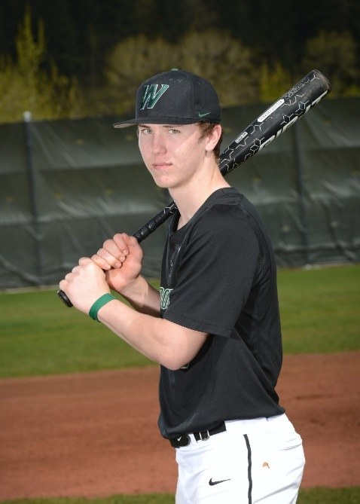
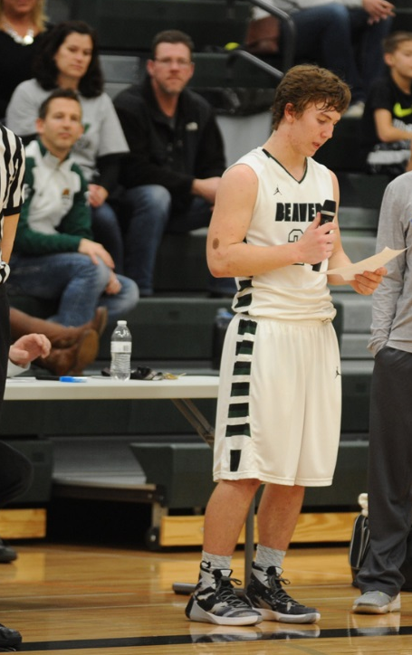
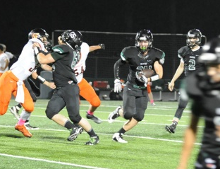
Accomplishments
Tristan Thomas
Junior
3 year letter winner in Football
  HM all-league (gr 10)
  TDN all-area 2nd team (gr 10)
  1st team all-league (gr 11)
  TDN all-area 1st team (gr 11)
  Coaches award (gr 11)
  Team Captain (gr 11)
  Bruce Wallila Memorial award (gr 11)
  Team MVP (gr 11)
2 year letter winner in Baseball
  HM all-league (gr 10)
  Rookie of the Year (gr 10)
  1st team all-league (gr 11)
  Team MVP (gr 11)
  Team Silver Slugger Award (gr 11)
  Team leader in hits, doubles and RBIs (gr 11)
  Member of 20 hit club and 15 RBI club (gr 10, 11)
  Team Captain
  Columbian all-region nominee (gr 11)
1 year letter winner in Basketball
3.2 GPA
Baseball (2)
Basketball (1)
Football (3)

Slide 33
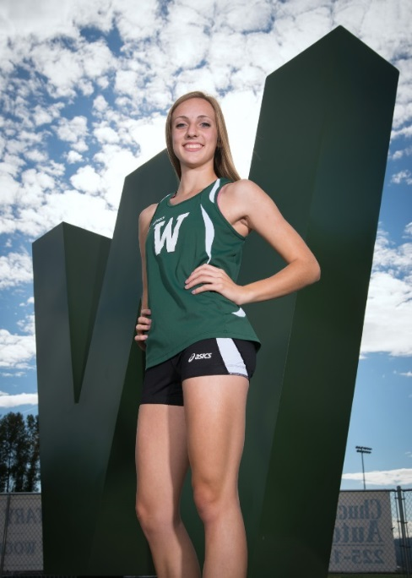
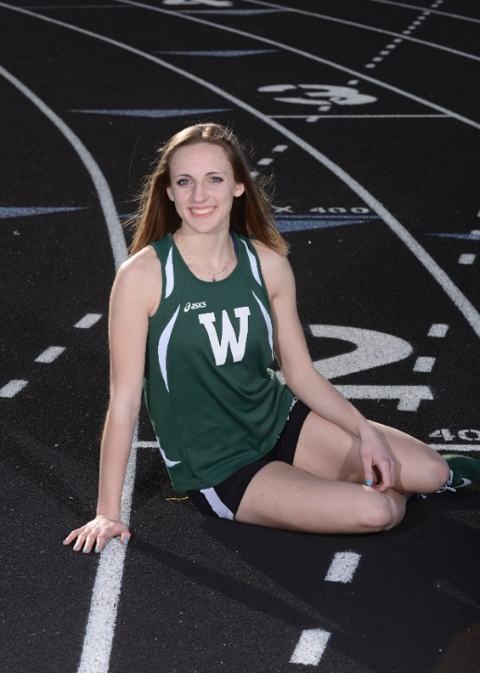
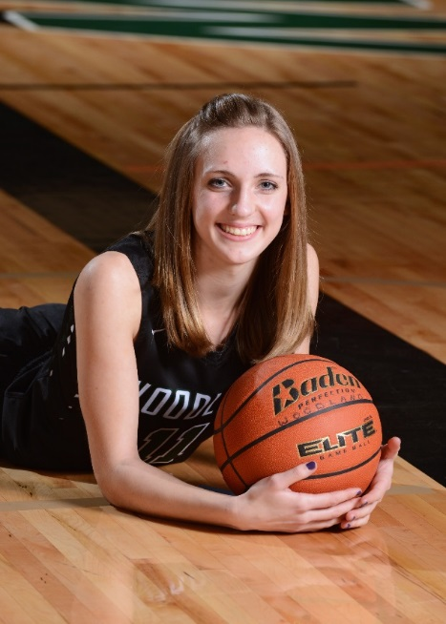
Julia Stepper
Junior
Accomplishments
Cross Country (1)
1 year letter winner Cross Country
1 year letter winner Soccer
  2nd team all-league (defense)
2 year letter winner Basketball
3 year letter winner Track and Field
  WIAA Athlete of the Week (gr 9)
  WHS Rookie of the Year (gr 9)
  2nd in state in 200m (gr 9)
  6th in state in long jump (gr 9)
  8th in state 4x100m relay (gr 9)
  District champion in 100m, 200m and long jump (gr 9)
  6th in state in 100m (gr 10)
  6th in state in 200m (gr 10)
  7th in state in long jump (gr 10)
  Team MVP (gr 10)
  District champion in 100m, 200m and 4x100m relay (gr 10)
  Team Captain (gr 11)
  4th in state in 100m (gr 11)
  2nd in state in 200m (gr 11)
  2nd in state in long jump (gr 11)
  6th in state 4x100m relay
  Girls’ team placed 4th in state
  District champion in 100m, 200m and long jump (gr 11)
  Team MVP (gr 11)
Holds the school record in the 100m and 200m dash.
3.6 GPA
Track (3)
Basketball (2)

Slide 34
2016
WHS Athletes of the Year

Slide 35
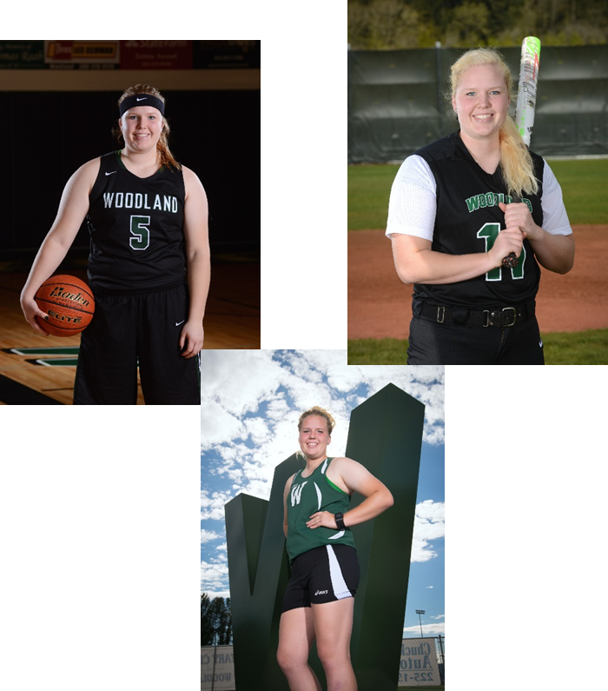
2016 WHS Female Athlete of the Year…
Jessica Flanagan

Slide 36

2016 WHS Male Athlete of the Year…
Tristan Thomas

Slide 37


WSD Athletics
Online Registration

Slide 38
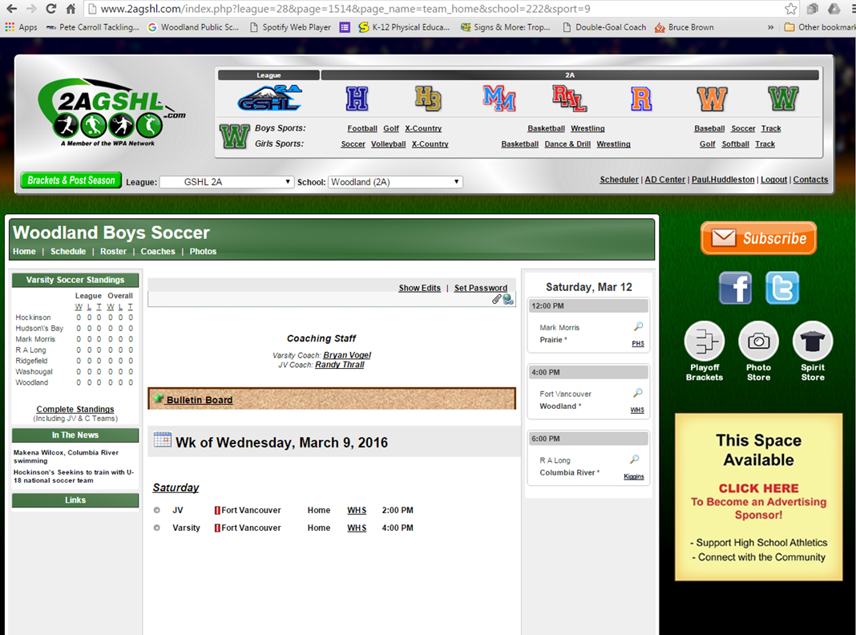
www.2agshl.com

Slide 39
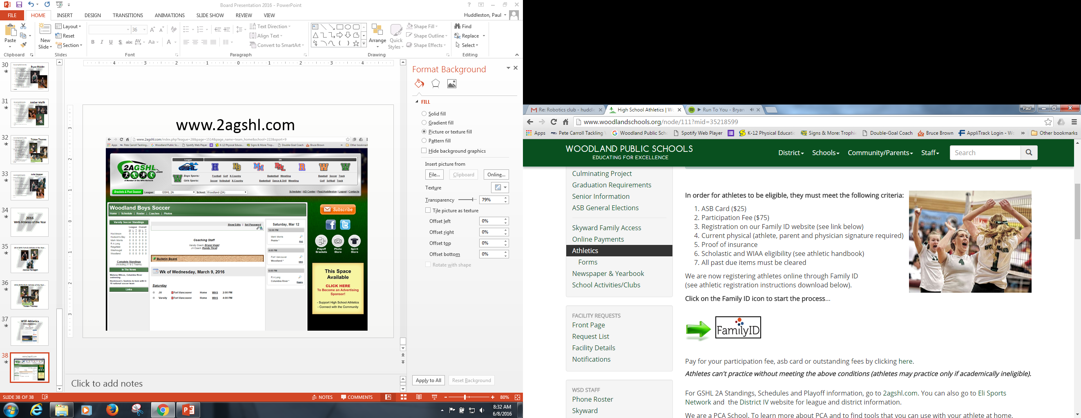
www.woodlandschools.org

